Slide 1
Forecasting Real Estate Values with Machine Learning: A Comparative Study of Methods and Attributes of Property structure
Host: Pooja Nayak
Date: 05-08-2024

Slide 2
Problem Statement
This dataset belongs to a Real Estate company that aims to determine accurate property price evaluations based on various location-based factors and other relevant attributes. The company intends to develop a sophisticated predictive machine learning model to analyse historical property prices and predict future values. This model will leverage comprehensive features, including geographic location, property size, amenities, neighbourhood characteristics, and market trends, to provide precise and reliable property price estimations. By integrating these data points into an advanced machine learning algorithm, the company seeks to enhance its pricing strategies, optimize property investments, and provide valuable insights to potential buyers and sellers in the real estate market.

Slide 3
About the Data No_of_columns – 9 No_of_Rows – 13320
area_type | availability | location | size | society | total_sqft | bath | balcony | price
Super built-up Area | 19-Dec | Electronic City Phase II | 2 BHK | Coomee | 1056 | 2 | 1 | $ 39.07
Plot Area | Ready To Move | Chikka Tirupathi | 4 Bedroom | Theanmp | 2600 | 5 | 3 | $ 120.00
Built-up Area | Ready To Move | Uttarahalli | 3 BHK |  | 1440 | 2 | 3 | $ 62.00
Super built-up Area | Ready To Move | Lingadheeranahalli | 3 BHK | Soiewre | 1521 | 3 | 1 | $ 95.00
Super built-up Area | Ready To Move | Kothanur | 2 BHK |  | 1200 | 2 | 1 | $ 51.00
Super built-up Area | Ready To Move | Whitefield | 2 BHK | DuenaTa | 1170 | 2 | 1 | $ 38.00
Super built-up Area | 18-May | Old Airport Road | 4 BHK | Jaades | 2732 | 4 |  | $ 204.00
Super built-up Area | Ready To Move | Rajaji Nagar | 4 BHK | Brway G | 3300 | 4 |  | $ 600.00
Super built-up Area | Ready To Move | Marathahalli | 3 BHK |  | 1310 | 3 | 1 | $ 63.25
Plot Area | Ready To Move | Sarjapur | 3 Bedroom | Skityer | 2250 | 3 | 2 | 148-150
Super built-up Area | Ready To Move | Mysore Road | 2 BHK | PrntaEn | 1175 | 2 | 2 | $ 73.50
Super built-up Area | Ready To Move | Bisuvanahalli | 3 BHK | Prityel | 1180 | 3 | 2 | $ 48.00
Super built-up Area | Ready To Move | Raja Rajeshwari Nagar | 3 BHK | GrrvaGr | 1540 | 3 | 3 | $ 60.00
Super built-up Area | Ready To Move | Ramakrishnappa Layout | 3 BHK | PeBayle | 2770 | 4 | 2 | $ 290.00
Super built-up Area | Ready To Move | Manayata Tech Park | 2 BHK |  | 1100 | 2 | 2 | $ 48.00
Built-up Area | Ready To Move | Kengeri | 1 BHK |  | 600 | 1 | 1 | $ 15.00
Super built-up Area | 19-Dec | Binny Pete | 3 BHK | She 2rk | 1755 | 3 | 1 | $ 122.00

Slide 4
Data Dictionary
Area_Type: The Type of Area of Property
Availability: Earliest time to move in the property, availability for possession.
Location: Locality or Area in the city
Size: Property Type (Like 3BHK, 4BHK)
Society: The property in the society or not
Total Sqft area: Area of property
Bathroom Nos: No of Bathroom in that particular Property
Balcony: No of Balcony
Price: Price of the property (target Column)

Slide 5
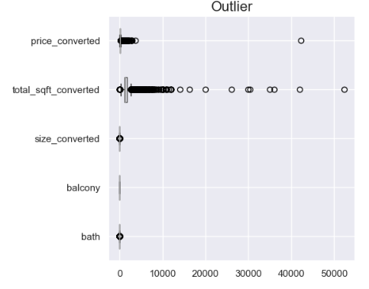
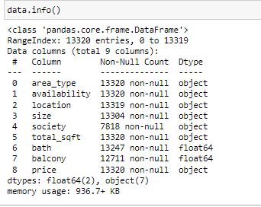
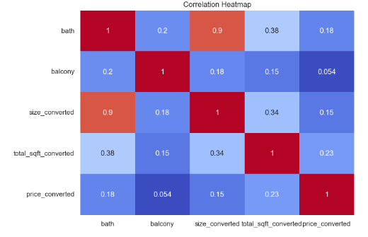
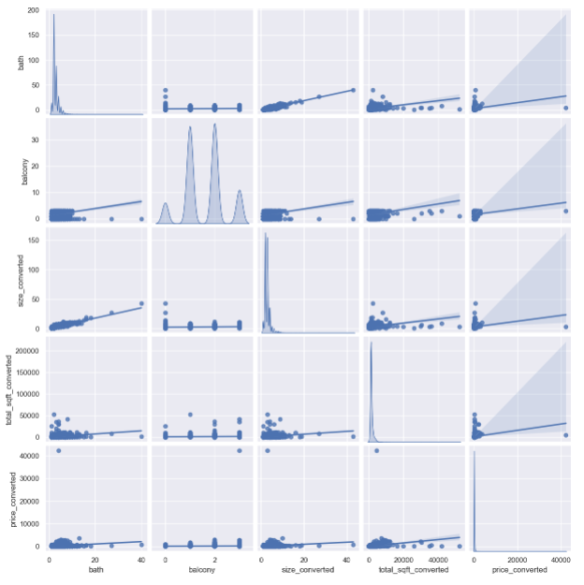
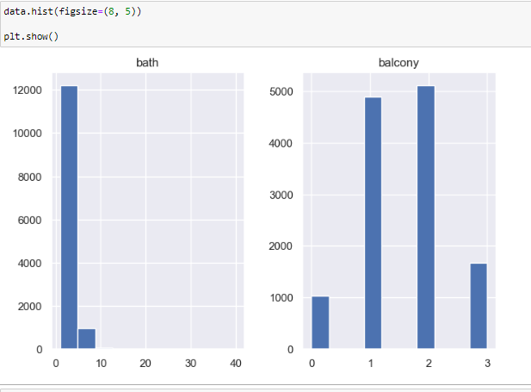
Exploratory Data Analysis (EDA)

Slide 6
Pre-processing
Eliminated Duplicate Records: Ensured data integrity by identifying and removing duplicate entries.
Addressed Missing Data: Utilized central tendency measures like mean, median, or mode to fill in missing values and maintain dataset completeness.
Handled Outliers: Applied techniques to identify and manage outliers to maintain accurate analysis and enhance model performance.
Encoded Categorical Variables: Used mean encoding to convert categorical data into numerical values, making it suitable for modeling.
Applied Feature Scaling: Adjusted the scale of independent variables to standardize data and improve the effectiveness and efficiency of the model training process.

Slide 7
Methodology
Regex for Imputation
Description: Applied regular expressions to handle missing data by identifying and filling missing values.
Reasoning: Regex allows for precise and flexible data cleaning, which is crucial for maintaining data integrity.
Univariate Analysis, Bivariate Analysis
Description: Examined the distribution of individual variables and Analyzed the relationship between two variables
Reasoning: Helps in understanding the central tendency, dispersion, and shape of data distribution for single variables.
Useful for identifying patterns and correlations between pairs of variables, informing feature selection and engineering.
Heat Map
Description: Visualized data using a matrix of colors to represent values.
Reasoning: Effective for identifying correlations and patterns in large datasets.
Measures of Central Tendency (Mean, Median, Mode)
Description: Calculated the average, middle, and most frequent values in the data.
Reasoning: These measures summarize the data and are fundamental for understanding its distribution.
Continued …

Slide 8
Encoding (Mean Encoding)
Description: Transformed categorical variables into numerical values by replacing categories with the mean of the target variable.
Reasoning: Helps in converting categorical data into a format suitable for machine learning algorithms.
Outliers Capping
Description: Adjusted extreme values to reduce their impact on the model.
Reasoning: Mitigates the influence of outliers, enhancing model performance and robustness.
Feature Scaling (Standardization)
Description: Standardized features by removing the mean and scaling to unit variance.
Reasoning: Ensures that all features contribute equally to the model, improving algorithm performance.
Train-Test Split, K-Fold Cross Validation
Description: Split the data into training and testing sets and used cross-validation for model evaluation.
Reasoning: Ensures model generalization and prevents over fitting.

Slide 9
Model Building
Modeling Used - Linear Regression (LR), Lasso, Decision Tree (DT)
Description: Implemented various regression and tree-based models.
Reasoning: Diverse models provide different strengths; LR for linear relationships, Lasso for feature selection, and DT for non-linear relationships.
Pipelines (Random Forest, Gradient Boosting, Lasso, Ridge, Elastic Net)
Description: Streamlined the workflow by chaining preprocessing and modeling steps.
Reasoning: Simplifies the process and ensures that the entire workflow is applied consistently during training and testing.

Slide 10
Model Evaluation
Grid Search Cross-Validation
Description: Optimized hyperparameters by exhaustively searching over a grid of possible values.
Reasoning: Enhances model performance by finding the best combination of hyperparameters.
R2 Score, Mean Absolute Error (MAE)
Description: Evaluated model performance using R2 (explained variance) and MAE (average absolute errors).
Reasoning: Provides a comprehensive assessment of model accuracy and reliability.
Saving the Model Using Pickle
Description: Serialized the trained model for future use.
Reasoning: Allows for easy storage and retrieval of the model for deployment or further analysis.

Slide 11
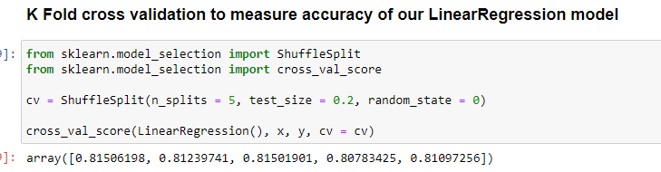
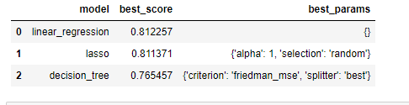

Insights and Findings

Slide 12
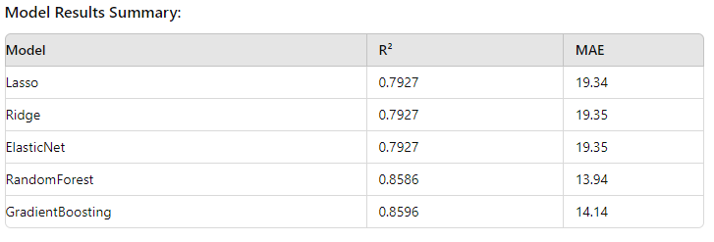
Conclusion
The RandomForest and GradientBoosting models performed significantly better than the linear models (Lasso, Ridge, ElasticNet), with higher R² scores and lower MAE values.

Slide 13
Thank You For Your Attention !

